Slide 1
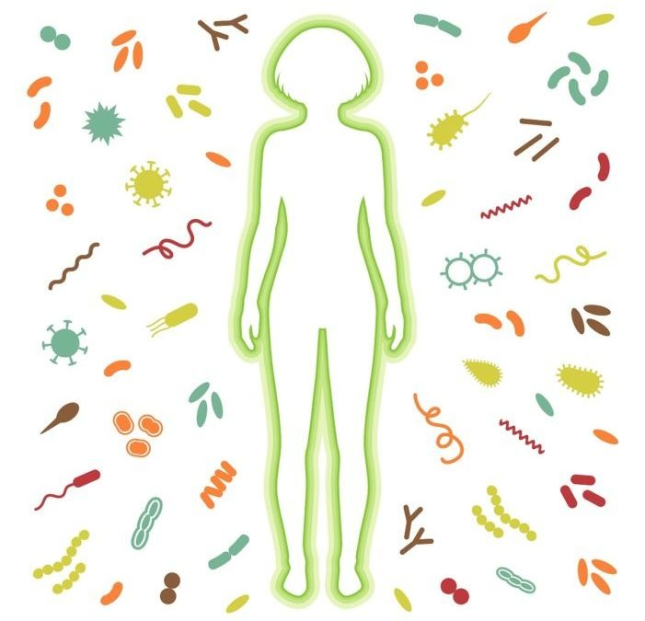
Your Immune System is Your Warrior!
Keep it Strong!

Slide 2
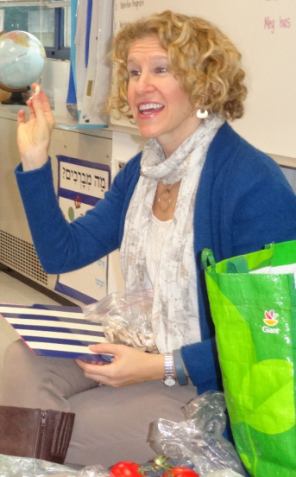
Lori Fish Bard, MS, HHC, AADP
Clinical Nutritionist &
Integrative Health Coach

Slide 3
YOUR IMMUNITY IS YOUR DEFENSE

Slide 4
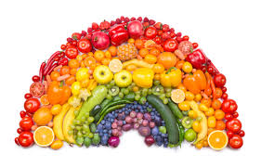
Eat the Rainbow
Eat as many colors as you can, including lots of antioxidant-rich fruits and vegetables and loads of greens.
Include cruciferous vegetables - at least 1 cup daily - including broccoli, kale, collards, Brussels sprouts, and cauliflower.
Aim for 8-10 servings a day

Slide 5
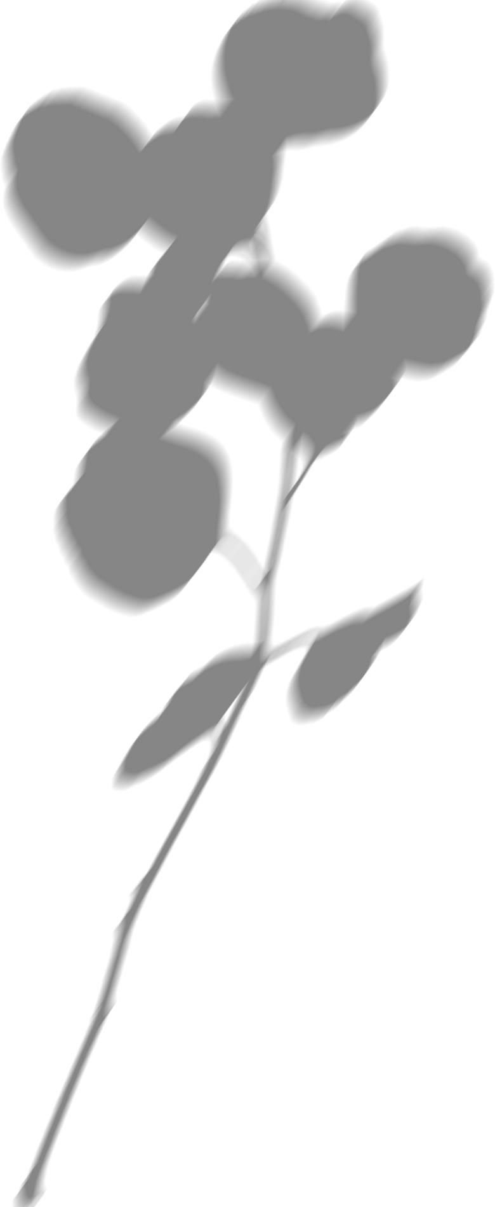
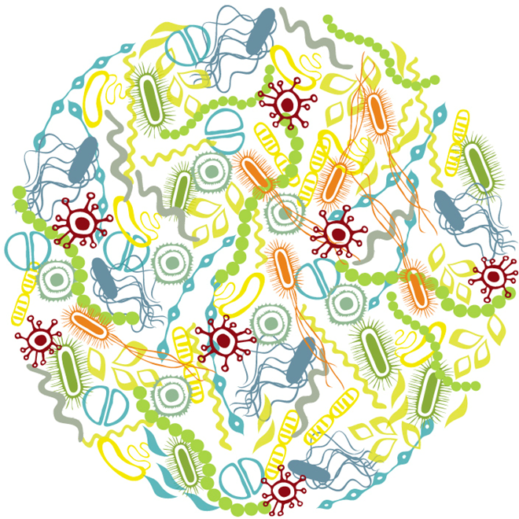
Support your
Microbiome
1. If your gut micobiome is comprised, the innate immune system is also compromised.
2. 80% of your immune system lives in your gut.
3. Eat fermented foods, take probiotics, eat prebiotic rich foods such as asparagus, artichokes and onions.

Slide 6
Prioritize Sleep
Restores and heals the body
Needed for optimal immune function
Set alarm to go to sleep
Aim for 7-8 hours per night

Slide 7
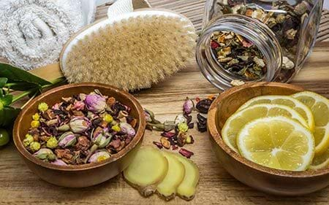
Love your Lymphatic System
Activate your lymphatic system through:
Massage
Dry brushing
Foam rolling
Bouncing on a rebounder
Using lemon and ginger

Slide 8
Stress Management
Exercise
Meditate
Yoga
Breathing exercises
Garden
Practice gratitude
Stay connected

Slide 9
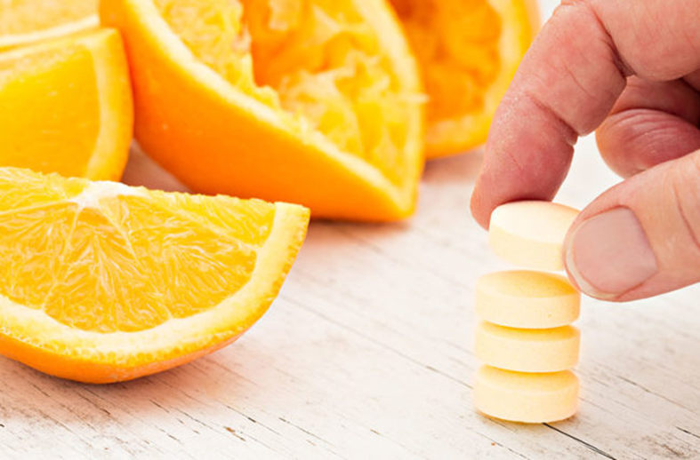
Immune support
Increase Vitamin C
Plays a central role in immune system, connective tissue, and heart and blood vessel health
Promising studies of Vitamin C as intervention for Covid-19
Aim for 1000-2000 mg /day

Slide 10
01
Plays a central role in immune system
02
Z is for Zinc
Antioxidant which protects body from oxidative stress
03
Have zinc lozenges handy anytime you feel as if you might be getting sick

Slide 11
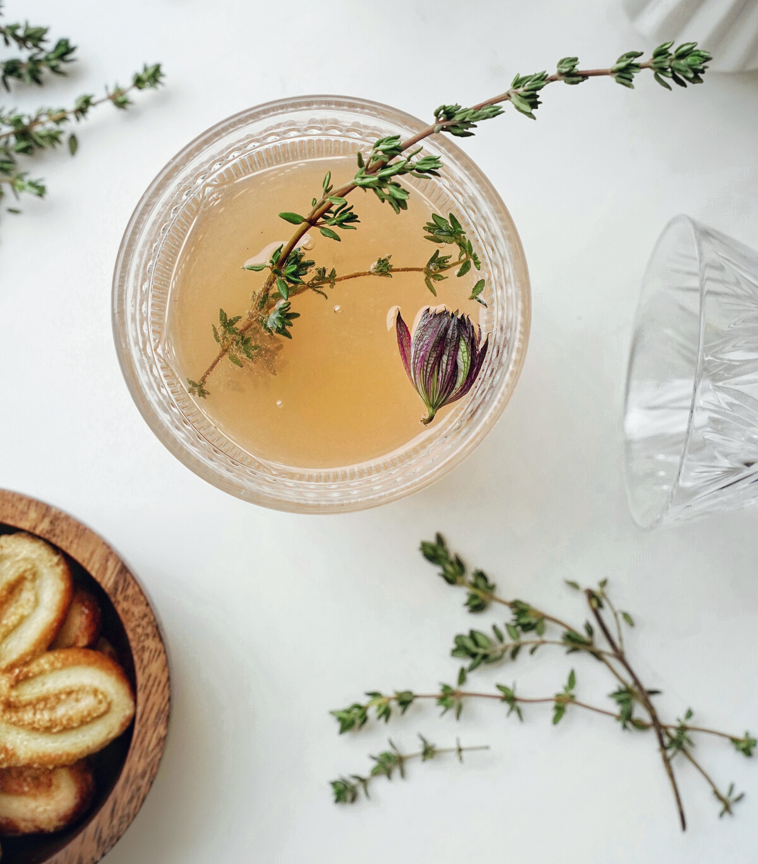
Immune support
NUTRITION
Colorful foods
Mushrooms
Garlic
Protein
SUPPLEMENTS
Glutathione
Vitamin D
Herbs:
Astragalus, elderberry, ginger, thyme & turmeric

Slide 12
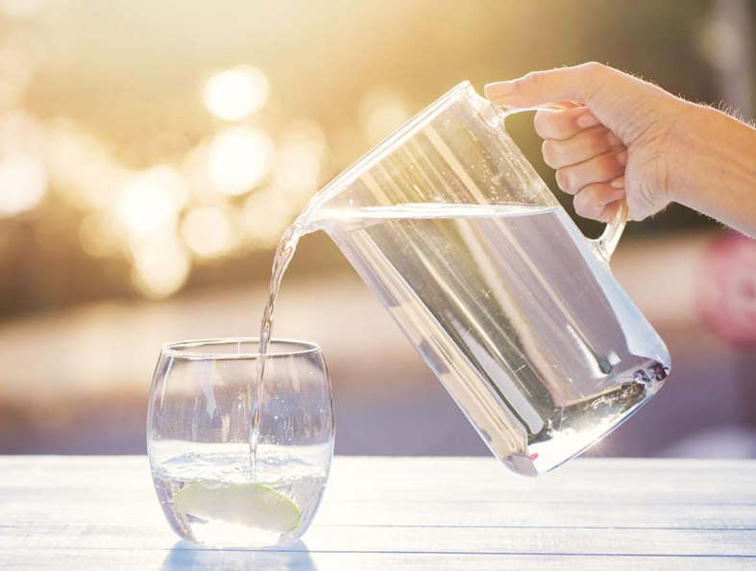
Drink lots of water
Keep well hydrated
Support your kidneys as they flush toxins out
Drink half of your body weight in ounces

Slide 13
Suppresses the immune system
Avoid refined and processed foods
Limit or avoid alcohol
Have protein at every meal
Limit Sugar

Slide 14
REFERENCES
Beard, J. A., Bearden, A., & Striker, R. (2011). Vitamin D and the anti-viral state. Journal of clinical virology : the official publication of the Pan American Society for Clinical Virology, 50(3), 194–200. https://doi.org/10.1016/j.jcv.2010.12.006
Gupta C., Prakash D. “Phytonutrients as therapeutic agents.” Journal of complementary & integrative medicine. 2014 Sep;11(3):151-69.
Volman, JJ. et al. “Effects of mushroom-derived beta-glucan-rich polysaccharide extracts on nitric oxide production by bone marrow-derived macrophages and nuclear factor-kappaB transactivation in Caco-2 reporter cells: can effects be explained by structure?” Molecular nutrition & food research. 2010 Feb;54(2):268-76. doi: 10.1002/mnfr.200900009.
Nantz, MP. et al. “Supplementation with aged garlic extract improves both NK and γδ-T cell function and reduces the severity of cold and flu symptoms: a randomized, double-blind, placebo-controlled nutrition intervention.” Clinical nutrition (Edinburgh, Scotland). 2012 Jun;31(3):337-44. doi: 10.1016/j.clnu.2011.11.019. Epub 2012 Jan 24.
Arreola, R. et al. “Immunomodulation and anti-inflammatory effects of garlic compounds.” Journal of immunology research. 2015;2015:401630. doi: 10.1155/2015/401630. Epub 2015 Apr 19.
Vighi, G. et al. “Allergy and the gastrointestinal system.” Clinical and Experimental Immunology. 2008 Sep; 153(Suppl 1): 3–6. doi: 10.1111/j.1365-2249.2008.03713.x
Daly, JM. et al. “Effect of dietary protein and amino acids on immune function.” Critical care medicine. 1990 Feb;18(2 Suppl):S86-93. Link.
Pendel, D. “How much protein do you need every day?” Harvard Health Blog. Harvard University. June 25, 2019.
Qin, Qiaojing, et al. “Astragalus Membranaceus Extract Activates Immune Response in Macrophages via Heparanase.” Molecules, vol. 17, no. 6, 13 June 2012, pp. 7232–7240., doi:10.3390/molecules17067232.
Jia, YY. et al. “Taraxacum mongolicum extract exhibits a protective effect on hepatocytes and an antiviral effect against hepatitis B virus in animal and human cells.” Molecular medicine reports. 2014 Apr;9(4):1381-7. doi: 10.3892/mmr.2014.1925. Epub 2014 Jan 29.
Han, H. et al. “Inhibitory effect of aqueous Dandelion extract on HIV-1 replication and reverse transcriptase activity.” BMC complementary and alternative medicine. 2011 Nov 14;11:112. doi: 10.1186/1472-6882-11-112.
Kim, HR et al. “Immune enhancing effects of Echinacea purpurea root extract by reducing regulatory T cell number and function.” Natural product communications. 2014 Apr;9(4):511-4.
Hawkins, Jessie, et al. “Black Elderberry (Sambucus Nigra) Supplementation Effectively Treats Upper Respiratory Symptoms: A Meta-Analysis of Randomized, Controlled Clinical Trials.” Complementary Therapies in Medicine, vol. 42, Feb. 2019, pp. 361–365., doi:10.1016/j.ctim.2018.12.004.
Grzanna, Reinhard, et al. “Ginger:An Herbal Medicinal Product with Broad Anti-Inflammatory Actions.” Journal of Medicinal Food, vol. 8, no. 2, 2005, pp. 125–132. doi:10.1089/jmf.2005.8.125.
Scaglione, F. “Efficacy and safety of the standardised Ginseng extract G115 for potentiating vaccination against the influenza syndrome and protection against the common cold [corrected].” Drugs under experimental and clinical research. 1996;22(2):65-72.
Salehi, B. et al. “Thymol, thyme, and other plant sources: Health and potential uses.” Phytotherapy research : PTR. 2018 Sep;32(9):1688-1706. doi: 10.1002/ptr.6109. Epub 2018 May 22.
Gupta, Subash C et al. “Therapeutic roles of curcumin: lessons learned from clinical trials.” The AAPS journal. vol. 15,1 (2013): 195-218. doi:10.1208/s12248-012-9432-8.
Moeller, Karla T et al. “The effect of hydration state and energy balance on innate immunity of a desert reptile.” Frontiers in zoology vol. 10,1 23. 4 May. 2013, doi:10.1186/1742-9994-10-23.

Slide 15
Q+A

Slide 16
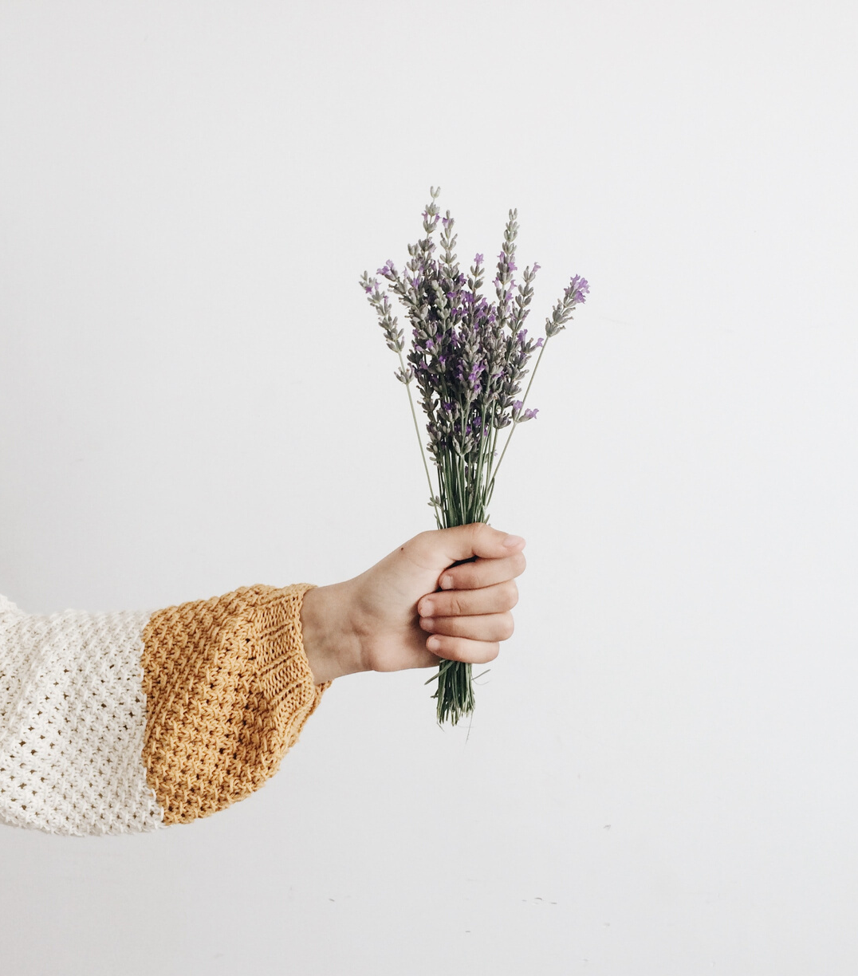
THANK YOU!
Lori Fish Bard, MS, HHC, AADP
Healthy Heartbeet Nutrition Counseling
www.healthyheartbeet.com
lori@healthyheartbeet.com

